Slide 1
Persons with Disabilities in Forced Displacement
Kirstin Lange
Senior Disability Advisor
UNHCR

Slide 2
Voices of refugees and IDPs with disabilities
“They underestimate us. They put us apart”
(Woman with a disability in Chad)
“Our capacity is so big, but they don’t know about that”
(Woman with a disability in Iraq)
“When you have a disability other people want to be far from you”
(Adolescent girl with a disability in Chad)
“I want to be a leader in this sense… the idea is for each [person with a disability] to be very active”
(Young woman with a disability in Ukraine)
“We feel like guests here now, there is no more welcome from the community”
(Man with a disability in Ukraine)
Notes:
I would like to start with sharing some words from refugees with disabilities themselves.
Many of these quotes are about capacity and about the contributions that refugees, IDPS and asylum seekers with disabilities can make to their families and communities. If adequately supported, refugees bring a wealth of skills and resources to their host country. However, refugees and asylum seekers with disabilities are often denied the opportunity to actively participate in the life of their communities, due to barriers and to discrimination on the basis of their disability and refugee/ asylum seeker status.

Slide 3
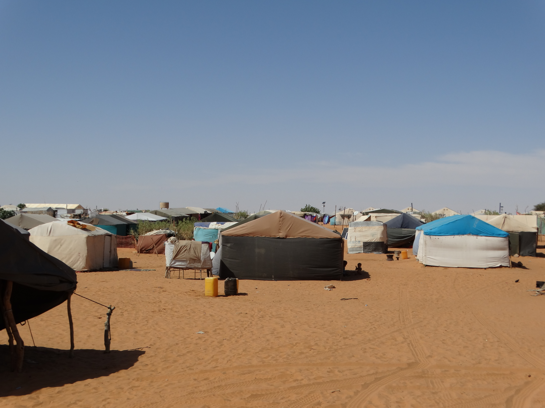
Mberra Refugee Camp,
Mauritania
Mahama Refugee Camp,
Rwanda
Notes:
Para 1- application of CRPD in situations of forced displacement

Slide 4
Global figures
By end 2015, 65.3 million people were forcibly displaced worldwide (21.3 million of these were refugees).
In 2015, an equivalent of 24 people were displaced every minute
Developing regions host 86% of the world’s refugees.
41% of refugees are in a protracted situation
107,100 refugees were admitted for resettlement in 2015
Estimated almost 9.8 million persons with disabilities displaced worldwide (based on WHO 15% estimate)
4
Notes:
The number of people forcibly displaced worldwide now surpasses 65 million. This number includes 21.3 million refugees and 3.2 million asylum seekers.
An estimated 12.4 million people were newly displaced due to conflict and persecution in 2015. This equates to 24 people every minute of every day.
An estimated 6.7 million refugees (41% of those under UNHCR’s mandate) were in a protracted situation at the end of 2015, and in 2015, only 107,100 refugees (out of more than 65 million) worldwide were admitted for resettlement.
Notes:
Who are ‘persons of concern to UNHCR’- refugees, asylum seekers, IDPs, stateless or at risk of statelessness
What is ‘forcibly displaced’?- persecution (refugees), generalized violence (IDPs) etc. Under UNHCR definition, doesn’t include natural disasters
Refugees include 5.2 million under UNRWA mandate.
Protracted situation- over 25,000 people displaced for more than 5 years.
Note of caution on figure for persons with disabilities- challenges around identification during registration. Need for capacity building of staff and mechanisms for identification beyond registration

Slide 5
Compounding barriers and risks
Compounding barriers to accessing work
Loss of livelihood assets on displacement; and discrimination on the basis of disability and refugee/ asylum seeker status
Compounding barriers to accessing education
- Limited availability of inclusive education in countries of origin and asylum, gaps in education due to conflict and displacement, and challenges adapting to a new curriculum and language
Compounding barriers to social inclusion
- Disability- related stigma, and rise in xenophobia and racism
Compounding risks of abuse and exploitation
- Loss of support networks, lack of familiarity with legal rights and service systems, lack of access to information and unclear legal status. Heightened risk of exploitation, violence and abuse en route to safety

Slide 6
Promoting the rights of persons with disabilities in UNHCR’s work
Age Gender and Diversity Policy
Partnership with Women’s Refugee Commission
‘Strengthening protection of persons with disabilities in forced displacement’ project:
Funded by Finland
Technical support in eight country operations
Focus on participation and partnership with DPOs
Mainstreaming:
Training and guidance
Policy and procedures
Partnerships

Slide 7
Data and monitoring
Identification: proGres database and Specific Needs Codes
Monitoring: UNHCR results framework
Reporting: AGD reporting

Slide 8
Challenges and opportunities
Shift from focus on vulnerability and ‘specific needs’, to participation and non- discrimination
Engagement with DPOs
Inclusion in national systems
Global Compact on Refugees and Comprehensive Refugee Response Framework

